Slide 1
Section 2.1
Graphing and Solving
Basic Functions
© Copyright all rights reserved to Homework depot: www.BCMath.ca

Slide 2
What are Transformations?
Transformations are geometrical changes made to a function
  Translations: sliding a graph up/down or left/right (2.2)
  Expansions/Compressions: wider or skinnier, scale factor (2.4)
  Reflections: flipping a graph over an axis (2.3)
Complex Transformations
  Inverse reflection – switching “x” and “y” variables (2.3)
  Reciprocal - taking the reciprocal of the function (2.6)
  ABS Value – abs of the “x” , “y” or both variables (2.6)
  Square Root – square root of a function (2.7)

Slide 3
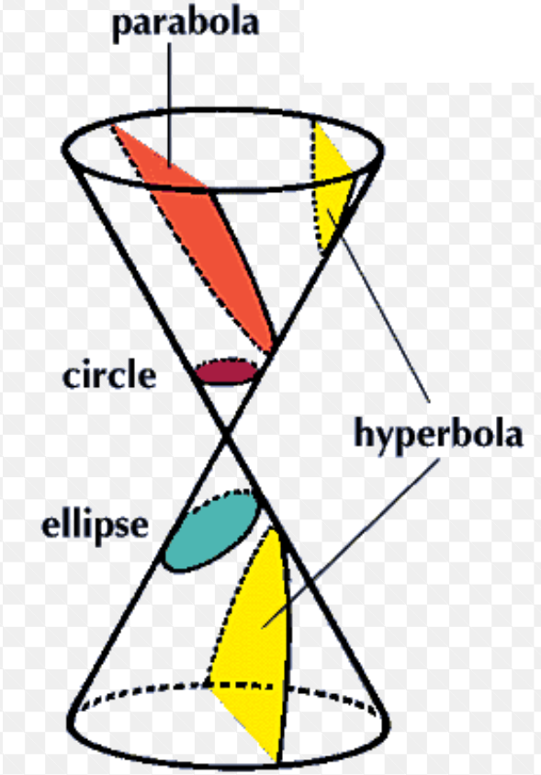
Basic Functions and Relations
A large part of the content in this course is on transforming functions
Here is a general list of all functions/relations that you need to know how to graph:
FUNCTIONS:
Polynomial Functions:
  Linear Function
  Quadratic Function
  Cubic Function
Radical Function
Exponential Function
Logarithmic Function
Trig Functions
RELATIONS:
Conics
  Horizontal Parabola
  Circles
  Ellipses
  Hyperbolas
Today’s lesson will provide a general overview of each of these functions and relations

Slide 4
Linear Functions:
Slope Y-intercept Form:
Point Slope Form:
General Form:
The P.S. form is used when you have the slope and a set of coordinates
With the general form, the exponents for “x” and “y” variables is one
Slope:
Y-intercept:
Domain:
Slope:
Range:
Y-intercept:

Slide 5
Practice: Find the equation of the line that goes through the points A(-11,7) and B(2.5, 9). Write your equation in the 3 different forms
Q2: Find the perpendicular bisector of segment AB. A(-11,7) and B(2.5, 9)

Slide 6
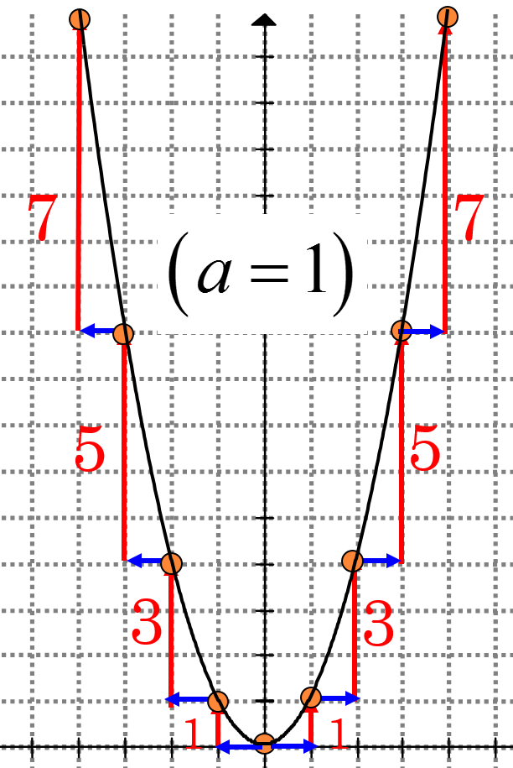
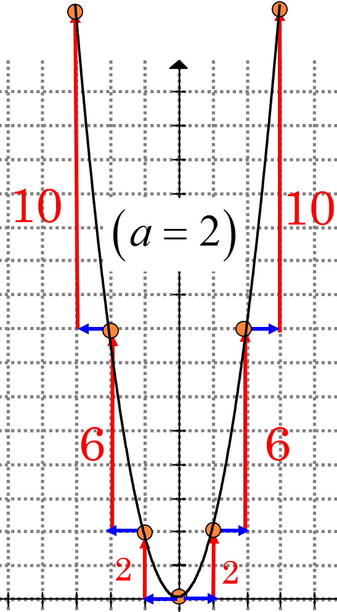
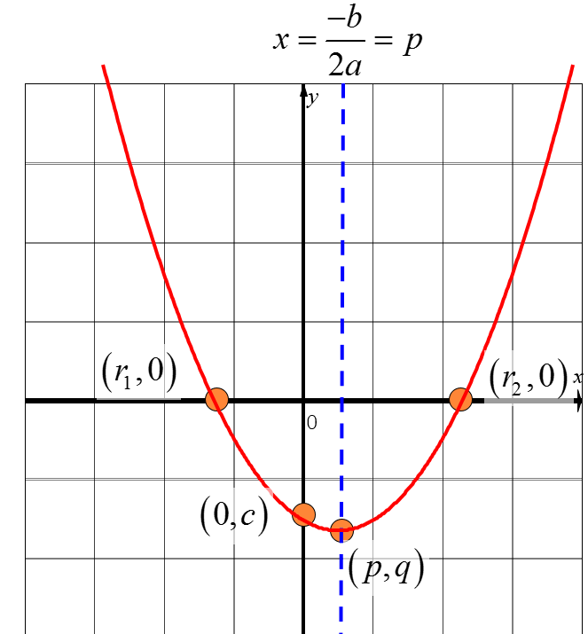
Quadratic Functions
Vertex Form:
General Form:
Factor Form
Y-intercept
X-intercept
Vertex:
Axis Of Symmetry
The constant “d” is a vertical shift of up/down “d” units
Axis Of Symmetry
Congruency factor:

Slide 7
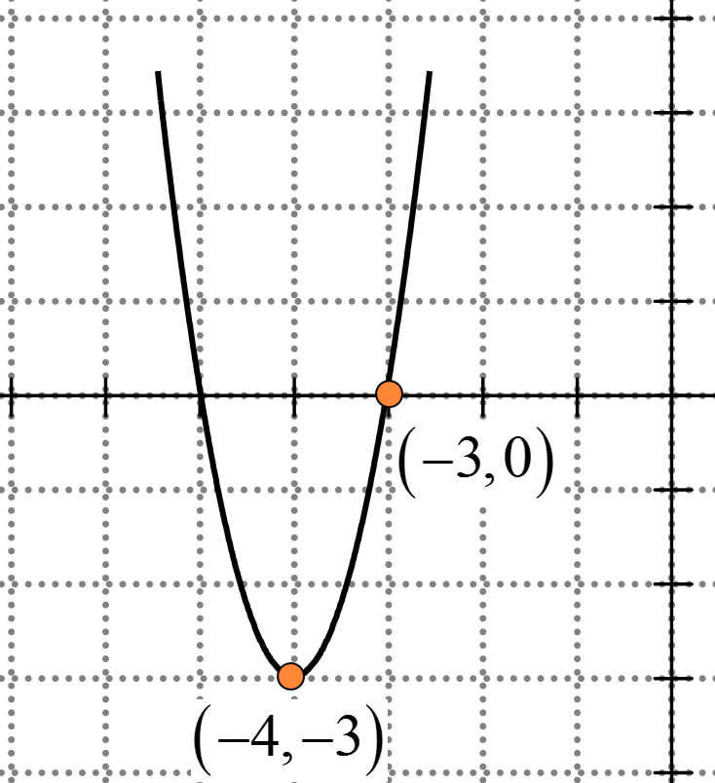
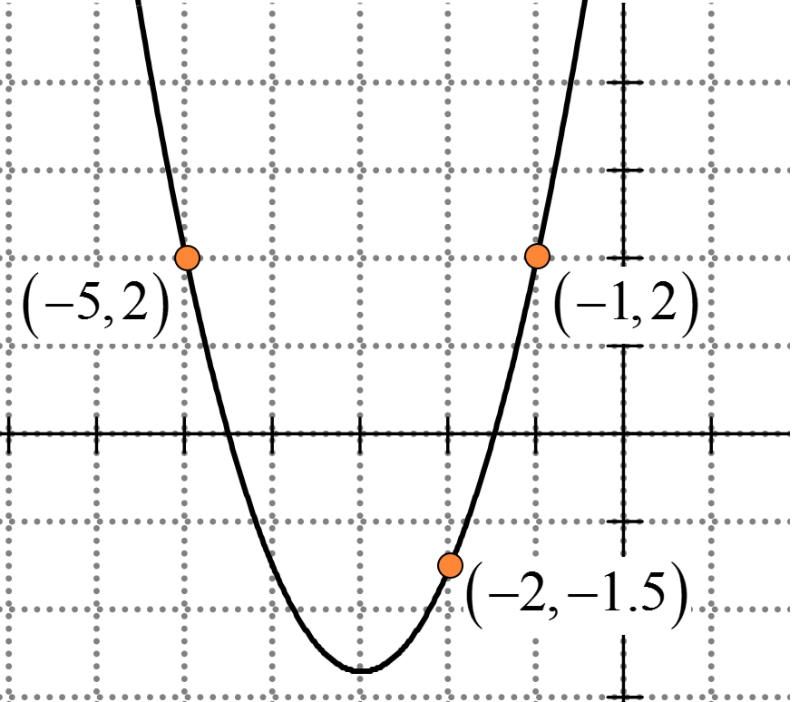
Practice: What is the equation of the parabola in the three different forms?

Slide 8
Cubic Functions and Other polynomial functions:
Cubic Function in Factored Form:
Cubic Function with double roots:
Polynomial function with Repeated Roots
X-intercepts:
Double Root:
Double Root:
Triple Root:
Quadruple Root:
A double root occurs when two roots are equal. The function will “bounce” back from the x-axis

Slide 9

Practice: Sketch each graph with the graph provided

Slide 10
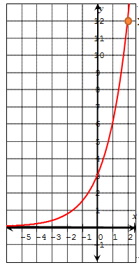

Exponential Functions
The graph of an exponential function is a curve that increases or decreases at a rate depending on the value of base “B”
Base “B” can not be negative, it becomes a discontinuous/complex function.
An exponential function will have a horizontal asymptote at y=d
Domain:
Range:
If Graph opens down ($a<0$)

Slide 11
Practice: Indicate whether if each of the functions will be increasing OR decreasing.
Q2: Indicate the y-intercept and the horizontal asymptote for each equation:

Slide 12
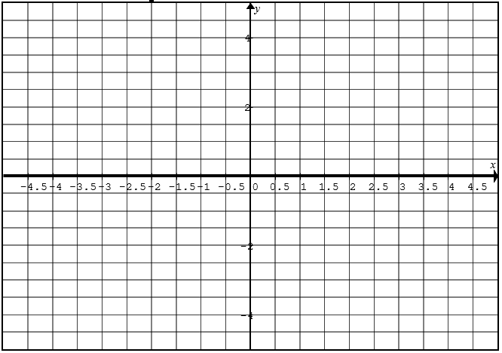
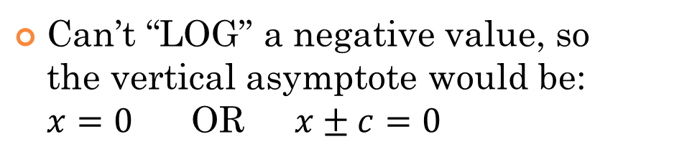
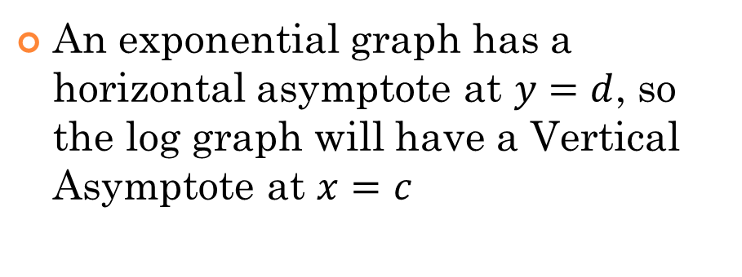
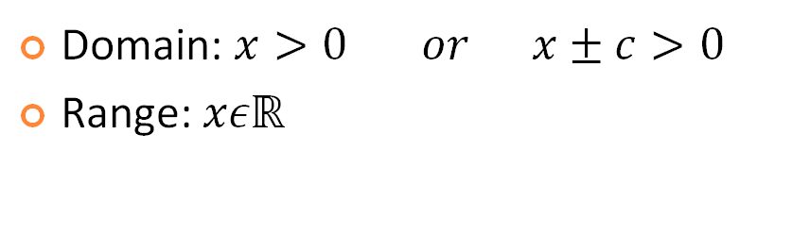
Logarithmic Functions:
A logarithmic function is an “inverse” of an exponential function:
Can’t “LOG” a negative value, so the vertical asymptote would be: $x=0$ OR $x±c=0$
Domain: $x>0 or x±c>0$
Range: $xεℝ$
Exponential Graph
An exponential graph has a horizontal asymptote at $y=d$, so the log graph will have a Vertical Asymptote at $x=c$
Logarithmic Graph

Slide 13
Practice: Indicate the domain and range for each log function. Then sketch the function on the grid provided

Slide 14
Relations: Circles and Ellipses
Circle:
Circle Center (h,k):
Ellipse:
To convert an equation from general form to standard form, you will need to Complete The Square!!
Major Axis: 2a
Minor Axis: 2b

Slide 15
Practice: Find the center and radius of each circle and graph it
Before you can graph this function, convert it to standard form by completing the square

Slide 16
Relations: Hyperbolas

Slide 17
Function Notations:
Function notations are used to represent a function and make it easier to recognize transformations made to a variable

Slide 18
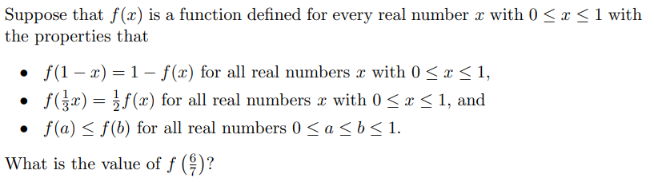

Slide 19
V) Reciprocal Functions
The reciprocal function takes the reciprocal of all the y-coordinates of a function
When graphing a reciprocal function, there are a three main steps:
The reciprocal of 1 or -1 will be the same, so points with a y-coordinate of 1 will not change
The reciprocal of zero is undefined, so points with a
y-coordinate of zero will become a vertical asymptote
Take the reciprocal of all y-coordinates to find where the points of the new function is.
  Reciprocal of large numbers become small
  Reciprocal of small numbers become large
© Copyright All Rights Reserved Homework Depot www.BCMath.ca

Slide 20
Graphing:
First look at the function in the denominator
Find the Asymptote and common points
Start from the asymptote, if the line goes up, the reciprocal goes down
If the line goes down, the reciprocal goes up
y
Domain: “x” can be all real
numbers except at x=0
5
x
Domain: “y” can be all real
numbers except at y=0
-5
0
5
-5
© Copyright all rights reserved to Homework depot: www.BCMath.ca

Slide 21
Practice: Given the following graph, draw the reciprocal function
y
Find the x-intercept → Vertical
Asymptote
5
Find common points with a
Y-coordinate of 1 or -1
Pick some points on the original
Function and take the reciprocal
of the Y-coordinate
x
-5
0
5
Reciprocal of large numbers
will become small
Reciprocal of small numbers
will become large
-5
© Copyright All Rights Reserved Homework Depot www.BCMath.ca

Slide 22
I) Graphing Exponential Function:
y
x
y
x
Domain:
Range:
© All Rights Reserved. Homework Depot www.BCMath.ca

Slide 23
II) Graphs of Exponential Functions
y
12
11
10
9
8
7
6
5
4
3
2
1
x
IF “B” is bigger, the graph will
go up faster!!
-5
-4
-3
-2
-1
0
1
2
-1
© All Rights Reserved. Homework Depot www.BCMath.ca

Slide 24
y
12
11
10
9
8
7
6
5
4
3
2
1
x
IF “B” is smaller, the graph will
go down faster!!
5
4
3
2
1
0
-1
-2
-1
© All Rights Reserved. Homework Depot www.BCMath.ca

Slide 26
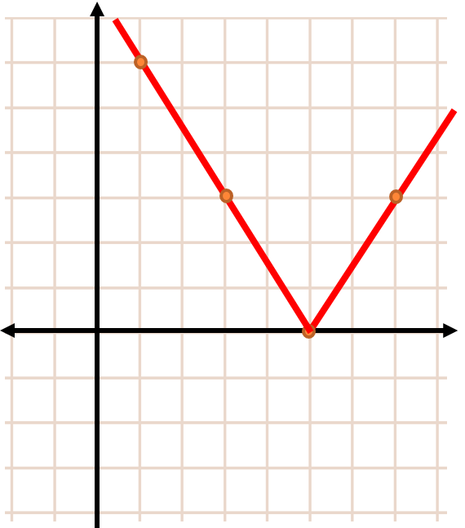

Slide 28
